Slide 1


University of New Haven – Fall 2023
DSCI: 6002 – 01 - Intro to Data Science – Final Project
Team - 16
Project Title
The cost effectiveness Analysis and Prediction
for Health Care

Slide 2




Team Members
Sathish Gandhi P R
Data Analysis, Deployment
Jar, Ayushi
Data Engineering, Modeling
Aithagoni, Mounika
Data Research
Kankanala, Sujith
Data Visualization

Slide 3

Business challenge
In order to maximize financial planning, increase transparency, and enhance the patient experience, how can we properly anticipate and estimate the future health insurance cost for a patient before their admittance to a hospital?
Individuals vary in both their body types and their living cultures. Therefore, depending on these circumstances, the diseases that affect them or the cost of treating them also differ. For instance, since smokers have a higher chance of developing a chronic illness, their medical insurance premium may be higher than that of a healthy individual free of bad habits.

Slide 4

Solutions
Data insights from an analytical dashboard that may be sent to healthcare and insurance providers.
Utilize advanced data analytics and predictive modeling techniques to analyze historical patient data and identify patterns in healthcare utilization.
An artificial intelligence (AI) based prediction model that projects future insurance costs.
Establish a feedback mechanism to gather input from patients regarding the accuracy of cost estimates and their overall satisfaction with the financial planning process.

Slide 5



Data Sources
Excellent resource as usual for locating datasets related to different fields besides healthcare.
CHDS
The goal of the Child Health and Development Studies databases is to study the generational transmission of health and disease.
Data.gov
US-focused healthcare data that can be found using a variety of criteria.
Provides datasets according to the priorities of global health.
Google Data Sets

Slide 6






Tools & Techniques
Programming language
Python
Math
Statistics, Linear Algebra Differential Calculus
Data analysis
EDA (Exploratory Data Analysis)
IDE
Jupyter
Data visualization
Matplot library, Seaborn
Deployment
Flask

Slide 7
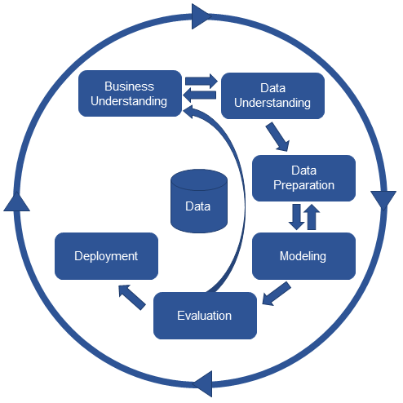
Methodology
Collect the hospital package pricing dataset
Explore and understand the data
Clean the data
Perform engineering and preprocessing to prepare for the modeling step
Select the suitable predictive model and train it with the data
Deploy the model on a live server and integrate it into a web application to predict the pricing in real time
Monitor the model in production and iterate

Slide 8
Project Timeline
Week 1
Data Research
Week 2
Week 3
Data Analysis
Week 4
Data Preparation
Week 5
Data Visualization
Week 6
Week 7
Data modeling
Week 8
Week 9
Evaluation
Week 10
Deployment

Slide 9
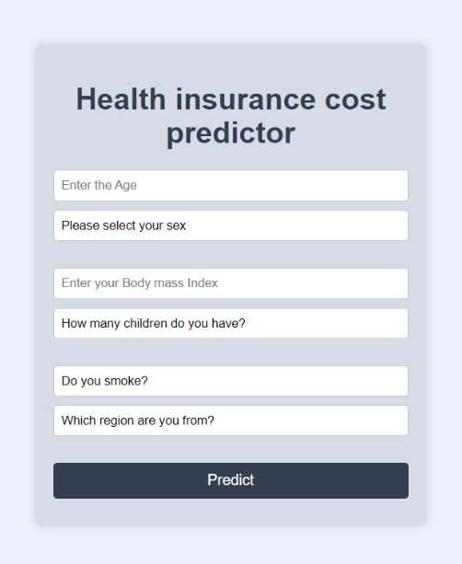
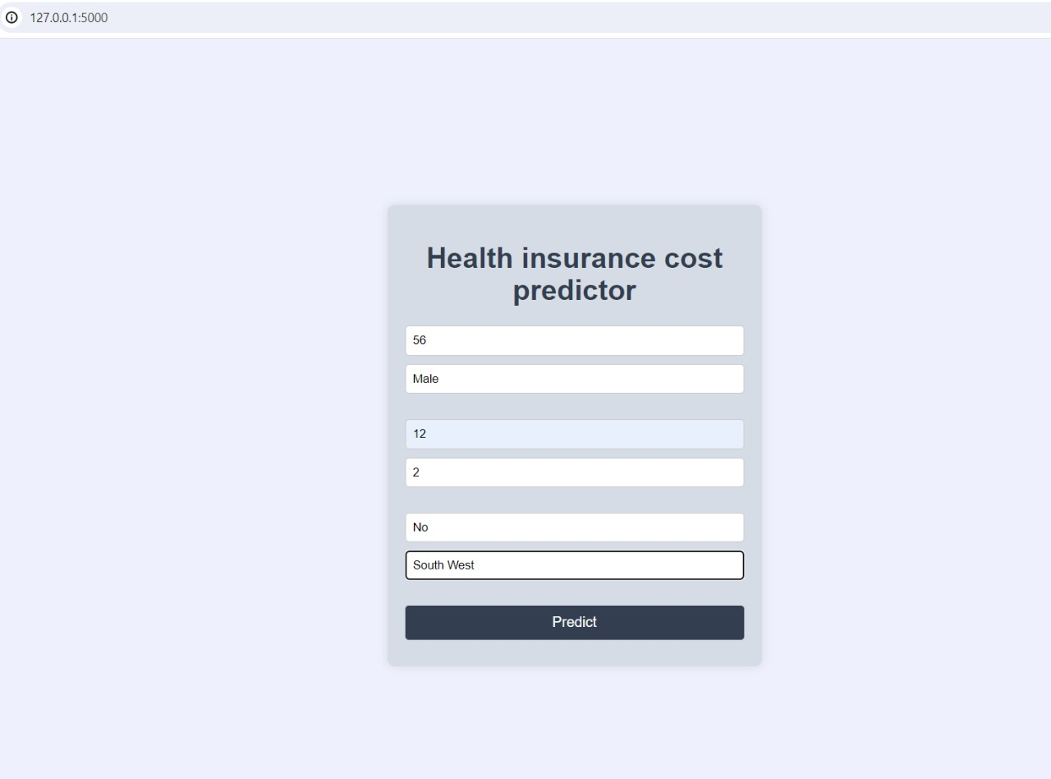
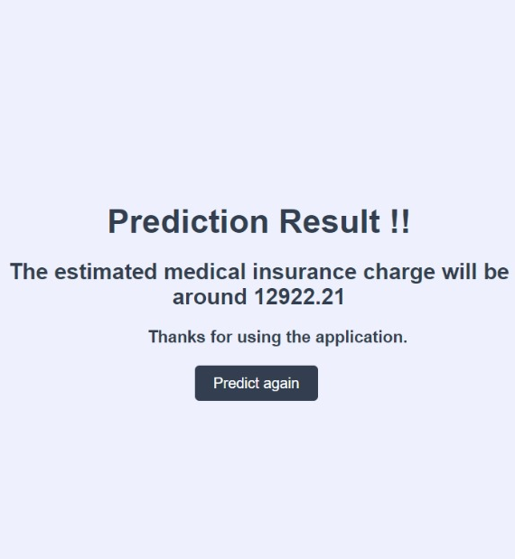
Model User Interface

Slide 10

Future Improvements
Important advancements for the project include obtaining a variety of datasets, putting strong data cleaning practices into place, investigating novel characteristics, and testing out different machine learning models in an effort to increase accuracy.
SAPH values and other explain ability strategies will be used to improve transparency. Priorities include addressing unbalanced data, ongoing observation, and prompt updates.
Important usability factors include a user-friendly interface, privacy, and security, as well as a smooth integration of the model with healthcare systems.
Fairness and other ethical issues will be dealt with beforehand, and continued success depends on staying current with machine learning and healthcare advances.

Slide 11

End

